Slide 1
An Introduction to SAM

Slide 2
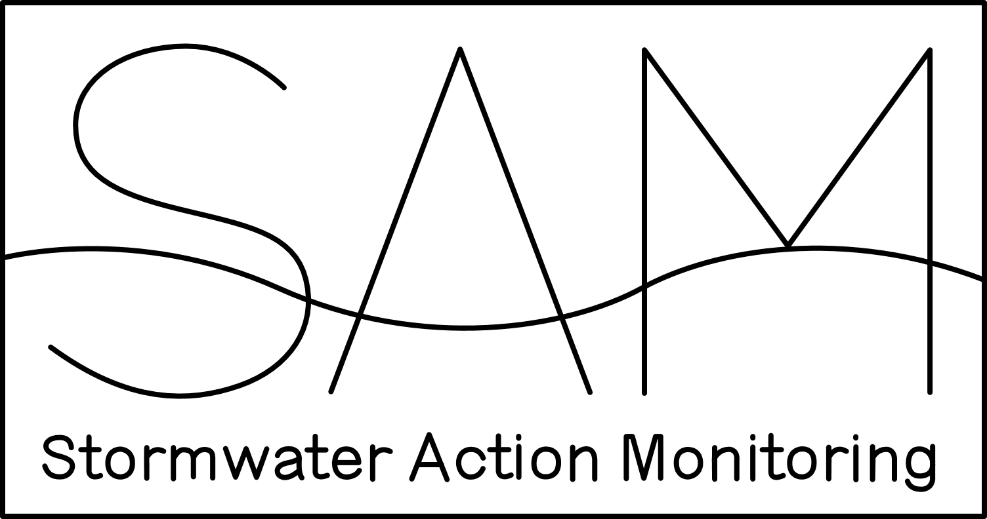
Stormwater monitoring that’s regional and collaborative.
- Funded by more than 90 Western Washington entities -
- Funded in kind by state, federal, local, private, and volunteer groups -
Notes:
Stormwater Action Monitoring (SAM) is a collaborative, regional stormwater monitoring program that is funded by more than 90 Western Washington cities and counties, the ports of Seattle and Tacoma, and the Washington State Department of Transportation. Ecology, WSDA, USGS, Penn Cove Shellfish, and local volunteer efforts contribute additional resources to conduct SAM studies.

Slide 3

Goal:
To improve stormwater management
Reduce pollution l improve water quality l reduce flooding
Notes:
SAM’s goal is to improve stormwater management to reduce pollution, improve water quality, and reduce flooding. We do this by measuring stormwater impacts on the environment and evaluating the effectiveness of stormwater management actions.

Slide 4

Why:
Stormwater pollution is a major threat.
It can release pollutants, cause flooding, erode streams,
harm salmon, and more.
Notes:
Stormwater pollution is one of the biggest threats to western Washington streams, lakes, and Puget Sound. Unmanaged stormwater runoff from developed areas drains to local water bodies, where it releases pollutants, causes flooding, erodes streams, harms salmon, and closes shellfish beds. SAM measures effectiveness of actions and tracks regional progress reducing pollution and flooding associated with stormwater.

Slide 5
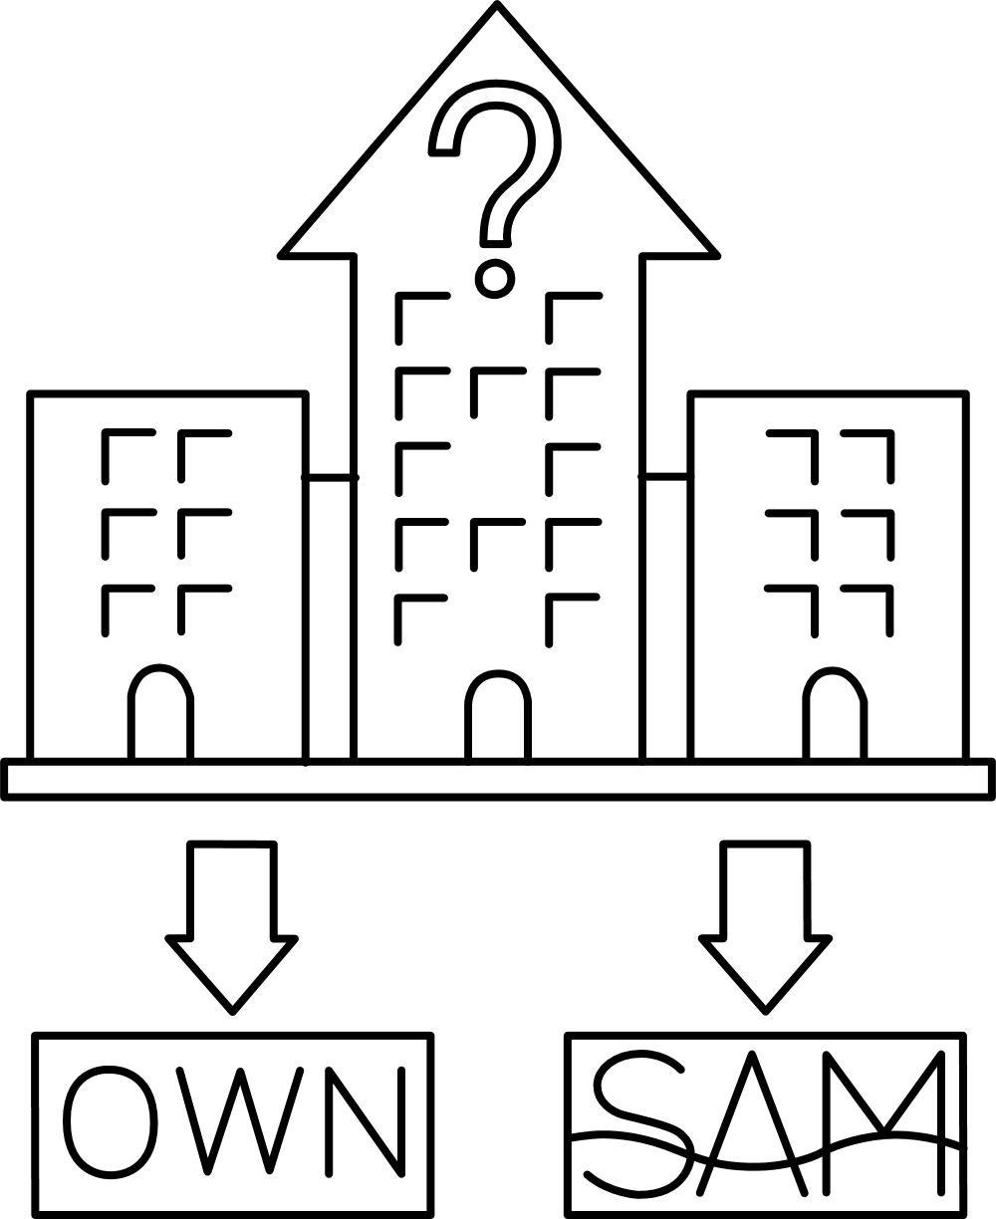

How:
A scientific, regional approach to effective
stormwater management.
Insights for stormwater managers, field practitioners, and policy makers.
Notes:
Each permittee decides whether to participate in SAM or conduct individual monitoring. Our jurisdiction contributes $__(see Appendix to permit)__ to SAM each year. SAM projects are identified in an open and coordinated way. The Washington State Department of Ecology serves as the administrative entity that manages SAM funds and executes SAM contracts. State and federal agencies provide in-kind leadership and support on projects.

Slide 6

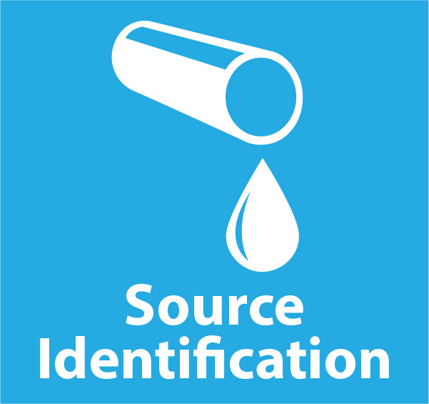
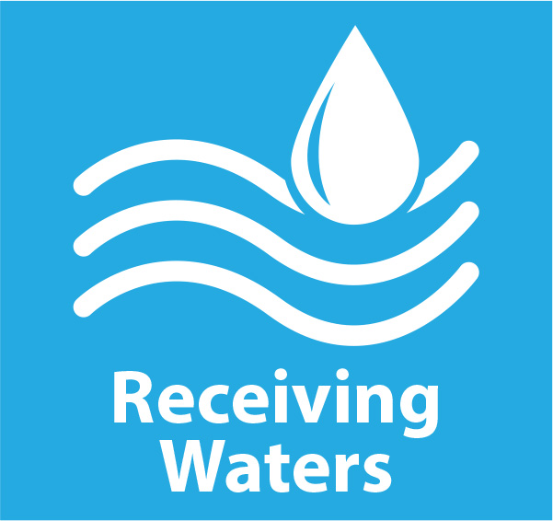
Focus Areas:
Notes:
The goal is to capture a regional understanding of how management actions can lead to results. Stormwater managers, field practitioners, and policy makers can use SAM findings to improve management practices and to set project and funding priorities. SAM efforts produce actionable findings in three focus areas. I’m going to share a few examples of what we’re getting back from SAM.

Slide 7
How well are required or innovative stormwater management practices working?
Notes:
Our effectiveness studies answer why or why not, and under what conditions, various management approaches work or fail.

Slide 8
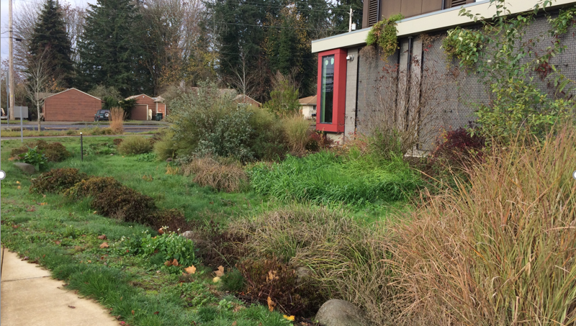
Bioretention using the default mix is working to control stormwater flows and most pollutants
Notes:
During the 2013 permit cycle SAM started eleven bioretention studies and we got a lot of information to make us feel more confident requiring folks to install these systems for stormwater flow control and treatment. The exception is that bioretention soil mix exports phosphorus and some nitrogen species. Care must be taken on siting them if there are sensitive waterbodies nearby.
We have learned that when properly designed and constructed they perform well hydrologically, and as the models predicted.
We have also learned that they reduce the toxicity of untreated stormwater and protect Coho from experiencing urban runoff mortality syndrome.

Slide 9
How can we best address the most common types of pollution in stormwater?
Notes:
Our source identification projects identify the most common problems and propose regional actions.

Slide 10
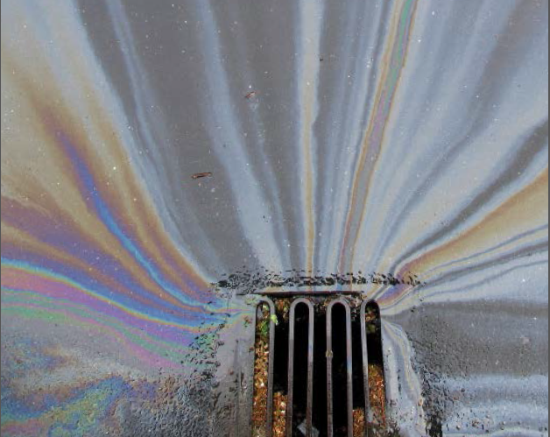
Most illicit discharges are vehicle-related incidents
Notes:
Most IDDEs across the region are vehicle accidents – but our IDDE programs respond to everything. Knowing this can help us use staff more wisely. SAM recommends our pollution prevention efforts should focus on vehicle related businesses, as well as food-related businesses and landscaping/construction. These are the business types where most follow-up inspections are needed to correct problems.

Slide 11
Is water quality getting better or worse in relation to stormwater management practices?
Notes:
Our receiving waters projects evaluate conditions in the water bodies that we are trying to protect. This approach is unique since no other monitoring in the state is designed to give feedback on the municipal stormwater permitted areas.

Slide 12
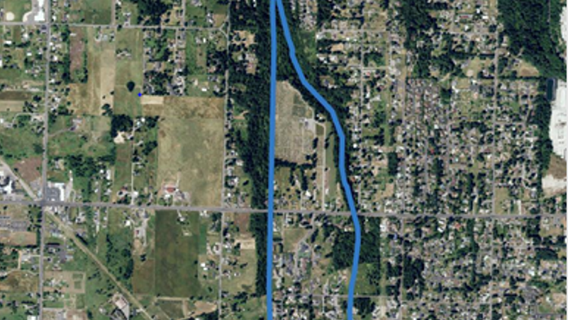
Watershed canopy correlates with B-IBI scores
Notes:
SAM monitoring in 2015 identified watershed canopy (tree cover) as the single most important variable controlling the health of biota in streams – even more than impervious surface. Preserving or restoring the canopy not only along riparian corridors but throughout the urban landscape may lead to improved health of our small local streams.

Slide 13

The Long View
SAM’s unique design provides flexibility to accomplish useful long-term results.
Notes:
SAM projects are not limited by grant program timelines or permit expiration dates. SAM projects deliver concrete interim and final products, and provide useful information throughout the duration of each individual project. SAM fact sheets summarize content of technical reports, and SAM’s annual and quarterly reports provide transparency and accountability for expenditure of the funds permittees contribute.

Slide 14

SAM Partners
SWG, PRO-Committee, state and federal agencies, citizen scientists
Notes:
The Stormwater Work Group (SWG), a formal stakeholder group, defines SAM activities. The Pooled Resources Oversight Committee (PRO-Committee), a subgroup of the SWG, oversees transparency, efficiency, and accountability of SAM expenditures. State and federal agencies also contribute to SAM

Slide 15
Value:
What’s the value of participating in SAM?
Maximize our stormwater management program
A clear, up-to-date picture of water quality in Western WA
More for our monitoring dollar
Notes:
SAM helps us maximize our stormwater management techniques –SAM’s studies help define best practices and provide insight for directing our limited resources for stormwater management.
We get a clear, up-to-date picture of water quality in Western WA – SAM’s studies offer unique insight into the conditions of receiving waters and help us understand how permit-required stormwater management efforts are working across the region.
We get more for our monitoring dollar – By joining in with other entities, we get studies that would be too complex to accomplish alone, or within typical grant funding cycles.

Slide 16
Learn More
www.ecology.wa.gov/SAM

